Slide 1

Sistemi Wearable e Telemetria Medica
A.A 2024-25
(Final course project)
Wireless UHF RFID based bladder pressure sensor
TASK 6.1
Laboratorio
Elettromagnetismo
Pervasivo
Prof. G. Marrocco
Tutor: Ing. Francesca Nanni
1

Slide 2
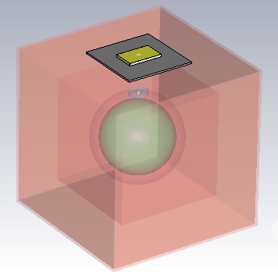
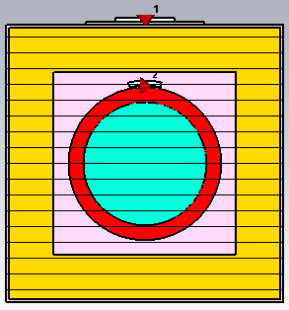
Modeling
Body fluid
(r = 41.5mm)
Slot
Tag
Fat
(183x183mm)
Skin
(187x187mm)
Muscle
(123x123mm)
Bladder
(thickness = 10mm)

Slide 3
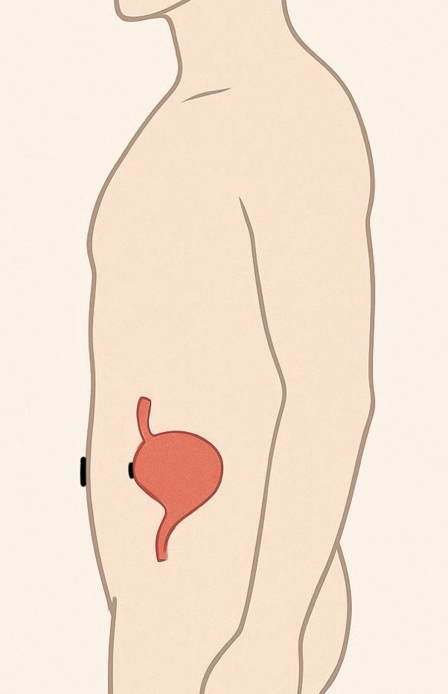
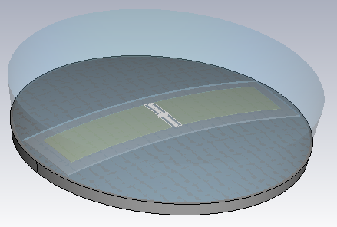
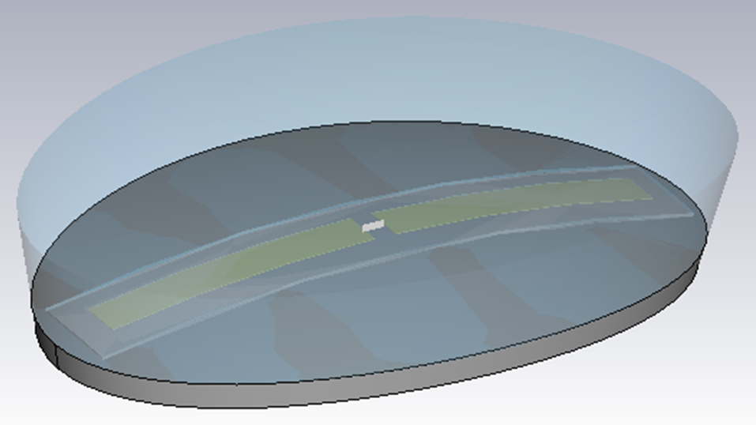
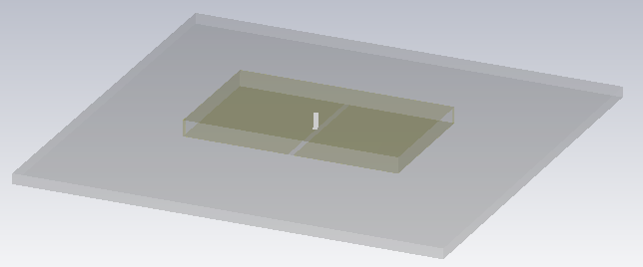
Modeling
Dipole RX with circular encapsulation on external bladder wall
Dipole RX with elliptical encapsulation on external bladder wall
Slot TX on abdominal skin

Slide 4
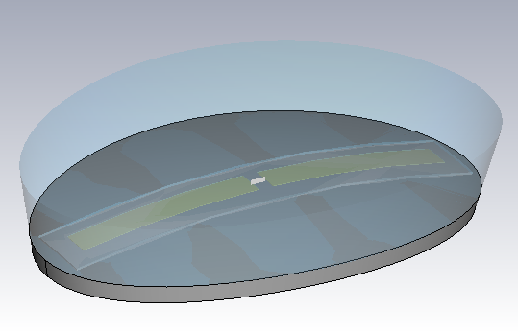
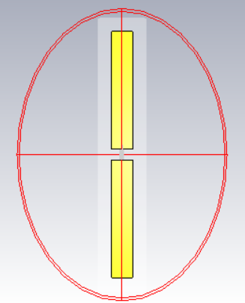

Encapsulation modeling
Elliptical cilinder
$$h_{impl}$$
Dipole
(LxW mm)
Incapsulation
(rmax =L/2 +1,5 mm;
rmin =7,5 mm)
Kapton [(L+2)x(W+2)mm]

Slide 5

Materials
From top to bottom: a layer of polystyrene (himpl) simulates the air above, followed by the RFID tag (0.035 mm), the insulating Kapton (0.125 mm) and a layer of silicone (1 mm). The entire system is externally coated with a protective film of Tegaderm, which guarantees biocompatibility and mechanical seal.
Tegaderm
Polystyrene
$$h_{impl}$$
Tag
0,035 mm
Kapton
0,125mm
Silicon
1mm

Slide 6


Elliptical cilinder encapsulation
MAG vs Dipole Lenght L
($h_{impl}$=3,5mm W=1,5 mm)
We choose L=27mm because it is compatible with the size of the trocar
27

Slide 7
Elliptical cilinder encapsulation
Zin vs Dipole Lenght L
($h_{impl}$=3,5mm W=1,5 mm)

Slide 8

Elliptical cilinder encapsulation
MAG vs Dipole Width W
($h_{impl}$=3,5mm L=18 mm)

Slide 9
Elliptical cilinder encapsulation
Zin vs Dipole Widht W
($h_{impl}$=3,5mm L=18 mm)

Slide 10
Elliptical cilinder encapsulation
MAG vs $h_{impl}$
(W=1,5mm L=18 mm)

Slide 11
Elliptical cilinder encapsulation
Zin vs${ h}_{impl}$
(W=1,5mm L=18 mm)

Slide 12
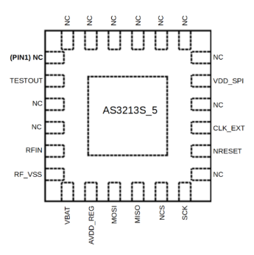

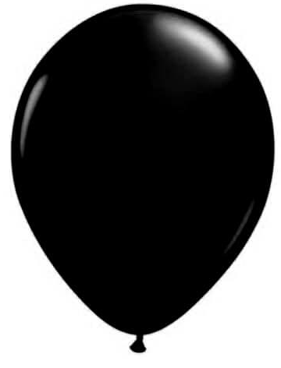

Approaching the final design
Adding chip footprint and matching the impedance
$Z_{chip}$ (@915 MHz)= 30 - i$∙$195Ω
Simulations
Real bladder
Bladder as a balloon

Slide 13
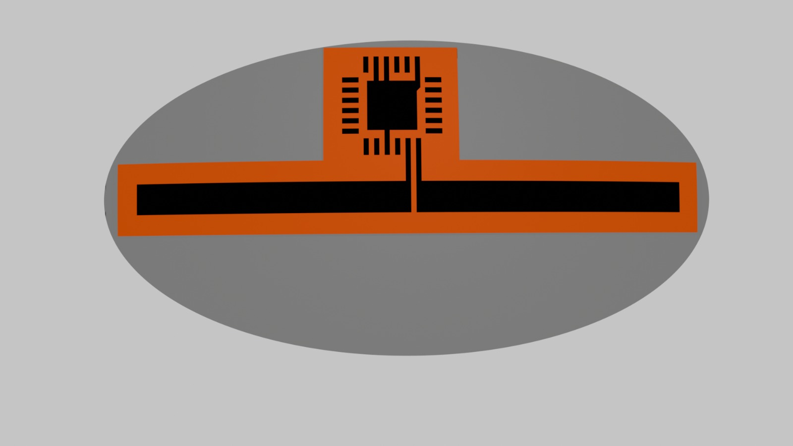
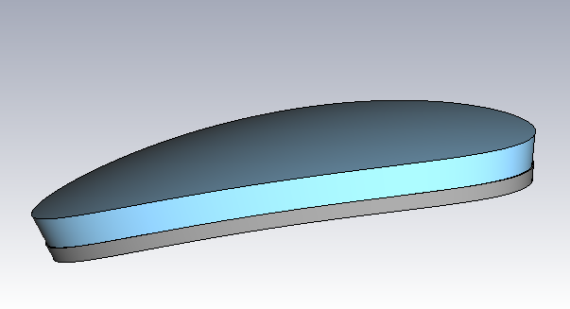
Final Model Dimension
Asygn AS3213S_5 Footprint
Dipole L = 27mm x W = 1.5 mm
Elliptical Incapsulation:
-Major axis 30 mm
-Minor axis 15 mm (during prototyping could be higher according to the ability in cutting thin kapton)
Elliptical Incapsulation:
-Bottom silicon layer 1 mm
-Top low-ε material himpl 2 mm

Slide 14
Real Bladder Tag Impedance
Including chip footprint
Half-Filled bladder
Empty bladder
Bladder | f [MHz] | Re(Zin) [Ω] | Im(Zin) [Ω]
Empty | 915 | 20.6 | -317
Half-filled | 915 | 20.9 | -317
Full | 915 | 20.6 | -314
Full bladder
No variations with filling condition (as we already knew)

Slide 15
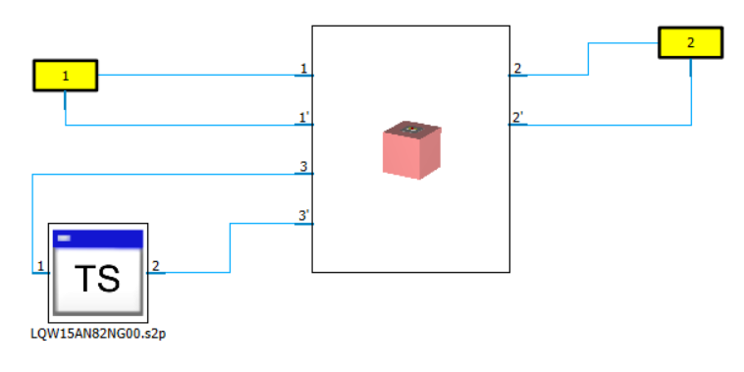
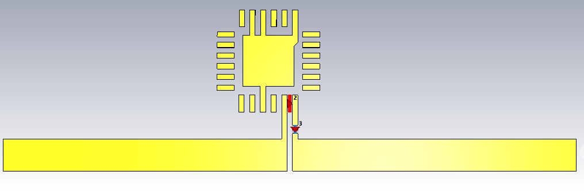
Schematic model
Ideally we would need an 89 nH series inductor to match chip's impedance
Reader Antenna
82nH inductor
According to available real inductors, 82 nH showed best performances

Slide 16
Real bladder τ
50% air and 50% urine
f [MHz] | τ
915 | 0.92

Slide 17
Real bladder GT
50% air and 50% urine
f [MHz] | Gt [dB]
915 | -30
Nothing changes between the three types of filling (empty, 50/50, full), therefore fluid in the bladder is not a determining factor.

Slide 18
Balloon's dielectric characteristics
Cole – Cole model for latex
Equation models the complex permittivity ε* as the sum of two dielectric relaxations and a conductivity term, where ε∞,d, Δε1, and Δε2 depend on the dry rubber content (DRC), σd depends on both temperature and DRC, and ε0,space is the permittivity of free space.
Used fluid: saline solution → ε= 72, σ = 1,5 (Very similar to the one used until now)
Balloon thickness considered= 0,1 mm
Results:
ε = 15
σ = 0,5
"Characterisation of the dielectric properties of rubber latex from 0.5 to 33 GHz"

Slide 19
Bladder as balloon τ
50% air and 50% urine
We ran all the simulations using always the same 82 nH inductor
f [MHz] | τ
915 | 0.97

Slide 20
Bladder as balloon GT
50% air and 50% urine
f [MHz] | Gt [dB]
915 | -29.7

Slide 21
Bladder as balloon τ
Full
With half and full filling conditions the impedance matching still reaches good values
f [MHz] | τ
915 | 0.97

Slide 22
Bladder as balloon GT
Full
f [MHz] | Gt [dB]
915 | -30.2

Slide 23
Bladder as balloon τ
Empty
Due to the thin layer of the balloon, the tag will sense the content of the "bladder". For empty configuration there is a big change in impedance
f [MHz] | τ
915 | 0.17

Slide 24
Bladder as balloon GT
Empty
Despite the matching worsening, a Gt = -35 dB should still be enough to communicate
f [MHz] | Gt [dB]
915 | -35.3

Slide 25
Conclusions
The simulated prototype showed good performances in almost all the cases, also considering a thin balloon instead of a realistic bladder.
82 nH Inductor can match the tag impedance for full and half filled bladder
Even in the worst case (empty bladder), the transducer gain should be high enough to close the communication link
Now it's time for prototyping...

